Slide 1
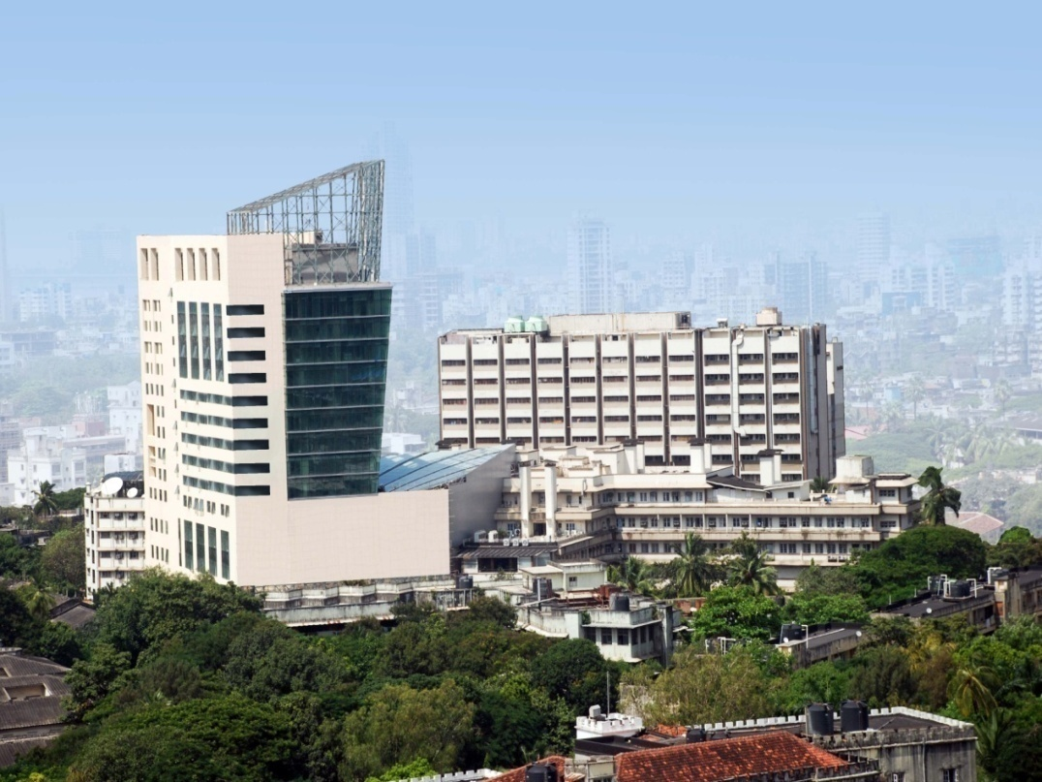
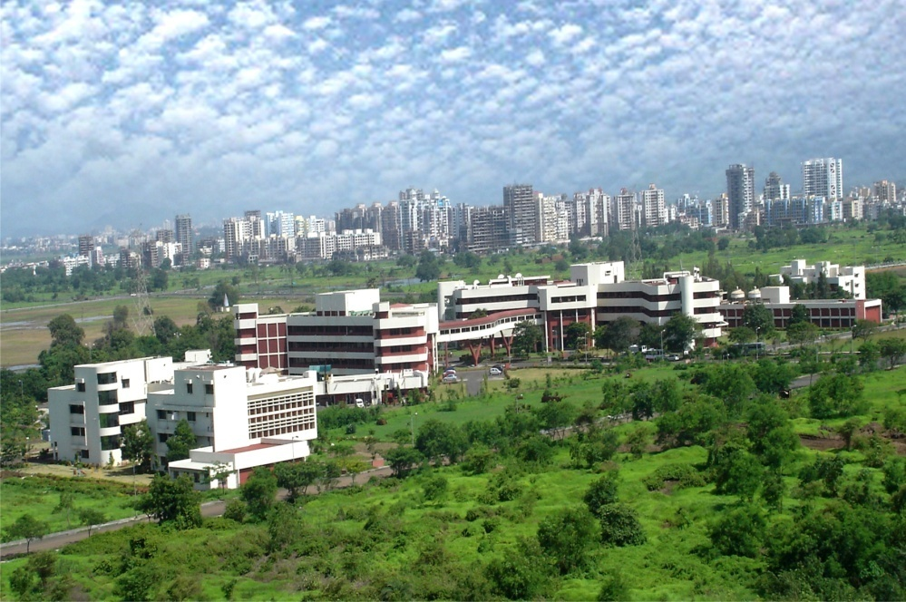
Sudeep Gupta, MD, DM
Professor of Medical Oncology
Deputy Director, ACTREC,
Tata Memorial Centre, Mumbai
sudeep.gupta@actrec.gov.in

Slide 2
Medical Applications of Radioisotopes

Slide 3
What are Radionuclides?
Unstable nuclides of elements
Emission of energetic rays in the process of becoming a different, more stable nuclide
Radioactive rays

Slide 4
Properties of Radionuclides
Emission of Radiation
alpha (α), beta (β) : particulates
gamma (γ) : non-particulate
varying energies
the radiations are easily measurable at very low amounts - high sensitivity
Transient - non-permanent
concept of half life; varying half-lives

Slide 5
Medical Applications
Therapeutic use in oncology and non-oncology areas
Diagnostic in-vivo imaging
static and dynamic imaging of organs;
understanding the functioning of vital organs
delineation of tumours etc.
Diagnostic in-vitro radiometric kits
hormones/drugs/antigens measurement in biological samples

Slide 6
Diagnostic Radiopharmaceuticals
In-Vitro : ‘in-glass’ or outside the body
Radiometric Assays (RIAs & IRMAs)
Nobel prize winning technology (Dr Yalow-1976)
Very useful tool in diagnosing diseases related to hormones; indispensable in pathology labs
More recently use in various areas : Tumor Specific Antigens, viral antigens, drugs with narrow therapeutic index, non-clinical applications
IRMA- Prostate Specific Antigen - Prostate Cancer

Slide 7
Diagnostic Radiopharmaceuticals : in-vivo
In-Vivo : ‘inside the body’
Static Imaging
Organ size, shape, abnormalities etc.
Thyroid, Liver, Kidneys, Brain, Skeleton, Lungs, malignancies
Presence of nodules, tumours, metastatic lesions, goitre, abscess, shrinkage etc.
Dynamic Imaging
Functioning of the organ, rate, output, defects etc.
Heart, Liver, Kidneys
Infarcted myocardium, hole in the heart, filtration defects in kidneys etc.

Slide 8
How are nuclear scans different?
X-ray, USG, CT scan – give anatomic information.
Nuclear scan provides unique FUNCTIONAL as well as ANATOMIC information
Molecular Imaging
Available for many organs

Slide 9
Molecular mechanism | modality | FUNCTION STUDIED
Glucose Metabolism | 18 F FDG | GLUT expressing tumors
Proliferation marker | 18F Thymidine | Haematolymphoid, early response
Hypoxia imaging | 18F MIZO/ 64Cu ASTM | Head neck, cervix Ca
Amino Acid metabolism | 18 F Tyrosine | Gliomas
DOPAMINE receptor | 18 F DOPA | Gliomas
Lipid Metabolism | 18 F Choline | HCC, Prostate
Somatostatin Receptor | 68Ga DOTA –TOC/TATE | Neuroendocrine tumors
Estrogen receptor expression | 18 F FESO | Breast, estrogen receptor expressing tumors
Apoptosis | 18 F annexin 99mTc –HYNIC - annexin | Cell death
SYMPORTER GENE EXPRESSION | 131i,I123,99MTcO4 I124 | Thyroid, breast
VEGF Expression | 99mTc – HYNIC- VEGF 18F-VEGF | Tumor angiogenesis

Slide 10
Positron Emission Tomography
Tomographic images of emitted positrons
Can be used to study metabolic processes
511 kEv gamma ray Photons emitted simultaneously at 180 degrees to each other
Evaluate location in space
Fusion imaging with CT and MRI scanning for precise localization
¹⁸F-Fuloro deoxy glucose (¹⁸F-FDG) most widely used tracer for PET
Notes:
Positron emission tomography, or PET scanning, allows for the obtaining of tomographic images of the interactions between positrons and electrons. This interaction can be used to study metabolic processes. When a positron interacts with an electron, there is a decay that takes place, and an annihilation that results in the ejection of two 511 KEV gamma rays. These photons are emitted and relatively simultaneously approximately 180 degrees to each other. We are able to evaluate the location of these interactions in space and project this information into the creation of images. By fusing the images obtained in the PET scanner with those obtained simultaneously or sequentially with the CT scanner this allows us to create precise localization of areas of abnormality.

Slide 11
DIAGNOSTIC NUCLEAR MEDICINE PET/CT at TMC
18F- PET/CT
68Ga RP
18F FDG
18F NaF
18F FLT
18F FMIZO
18F FET
68Ga DOTA NOC/TATE
68Ga PSMA
68Ga- NODAGA-RGD
68Ga- MAA

Slide 12
How has nuclear functional imaging made a difference?

Slide 13
Longest In-plane Diameter

Slide 14
Sum of Longest Diameter
Target Lesions
Sum of Longest Diameter

Slide 15
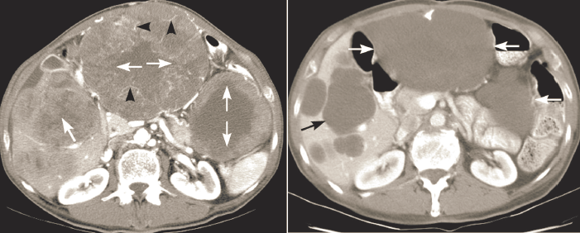
Before Treatment
After Treatment

Slide 16
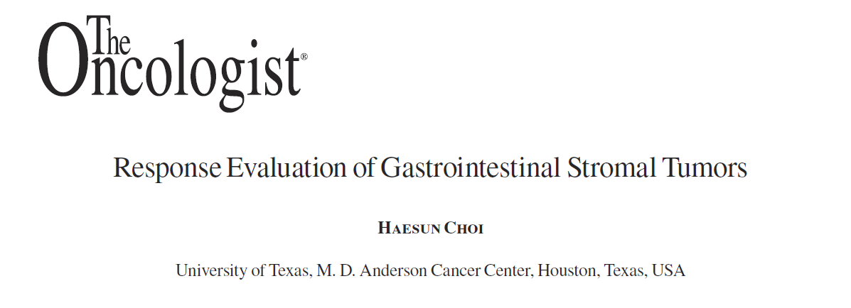

Slide 17
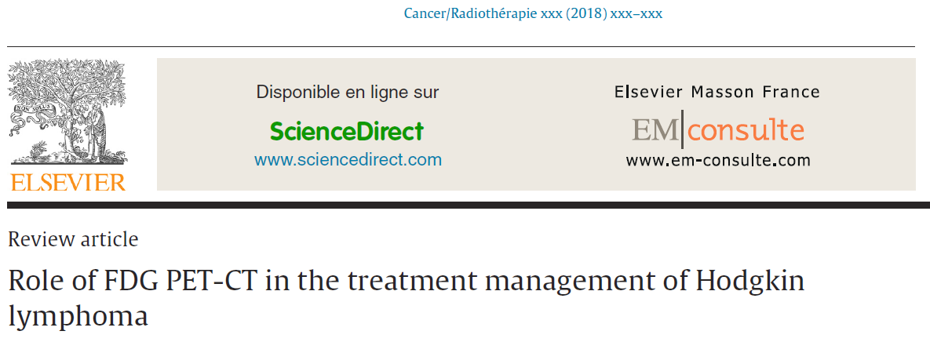
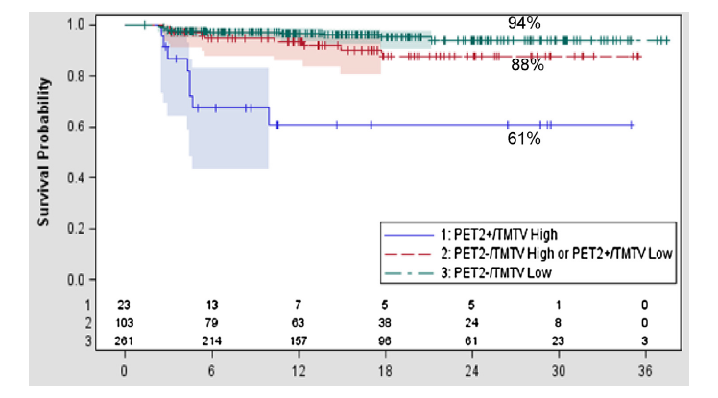

Slide 18
Therapeutic Radiopharmaceuticals
Deleterious effect of ionizing radiations on cells/organisms
Primarily cancers
Others : hyperthyroidism,
Systematic
Old - ¹³¹I, ³²P

Slide 19
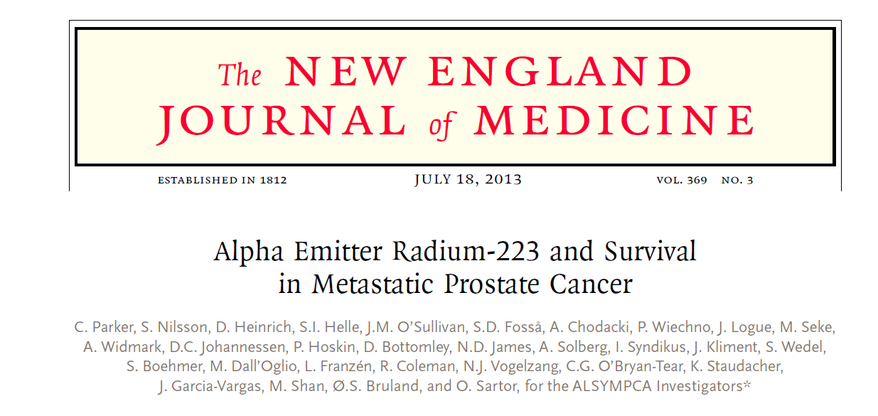

Slide 20
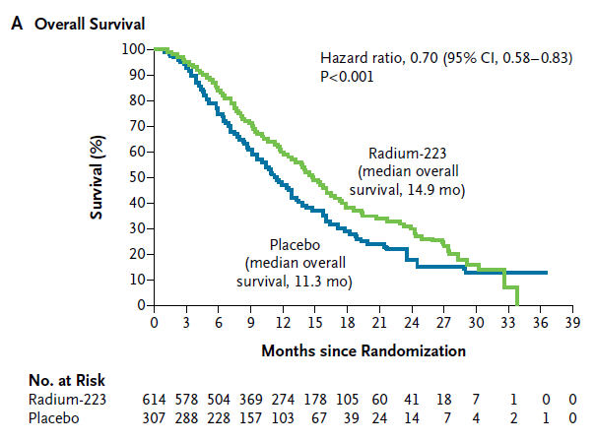

Slide 21
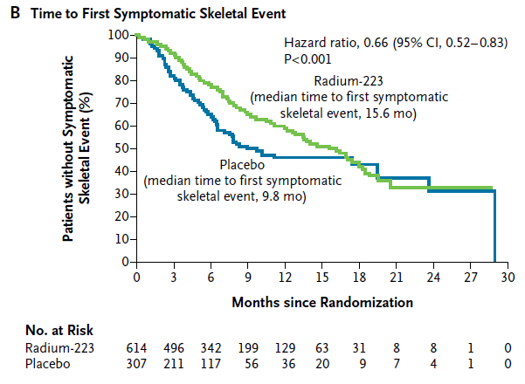

Slide 22
Collaboration with BARC for use of
Radio isotopes

Slide 23
Radioimmunotherapy (RIT) Making ‘smart bombs’ for cancer treatment

Slide 24
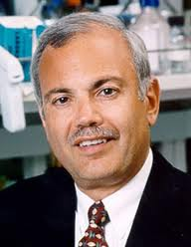
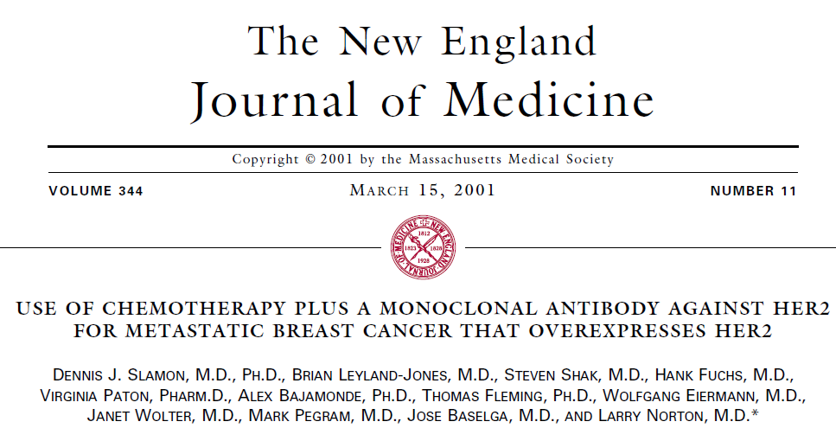
Approval of Trastuzumab for HER2-positive MBC
1998
First therapeutic antibody targeted at a cancer-related molecular marker to receive FDA approval
Notes:
Slamon DJ, Leyland-Jones B, et al. Use of chemotherapy plus a monoclonal antibody against HER2 for metastatic breast cancer that overexpresses HER2. N Engl J Med 2001; 344:783−792.

Slide 25
Slamon: Overall survival in HER2 3+ patients
1.0
0.8
0.6
0.4
0.2
0
Paclitaxel subgroup
H + P
P
Probability of survival
40%
18
25
0 5 10 15 20 25 30 35 40 45 50
Time (months)
Smith IE Anticancer Drugs 2001;12:S3–10
Notes:
Survival
Pivotal trial
Paclitaxel
SOTA II
February 2002
R. Bell

Slide 26
Can we reduce the cost of therapeutic antibodies AND make them more effective?
Conjugate the cold antibody to a radio-isotope of interest and create a ‘smart bomb’ to deliver targeted radiation to cancer cells.
Reduce the number of treatments required
(1-2) and reduce the cost by 90%

Slide 27
Radioimmunotherapy
Our 2 institutions have conjugated commonly available therapeutic antibodies for lymphoma (Rituximab) and breast cancer (Trastuzumab) with radio-isotopes (I-131 & Lu-177)
We have proven stable conjugation and tumor penetration in normal and tumor bearing animals
We have started human studies with these conjugates

Slide 28
% Injected dose / gram

Slide 29
Radioimmunotherapy
Based on these findings, the following clinical studies have been planned.
i) Dosimetry studies of ¹³¹I-rituximab in NHL patients to
understand tumor and vital organ exposure to radioactivity
ii) Dosimetry as well as therapeutic trials of ¹⁷⁷Lu-trastuzumab
in HER-2 positive breast cancer patients.
Likely to result in huge cost savings for treatment of cancer patients in India.

Slide 30
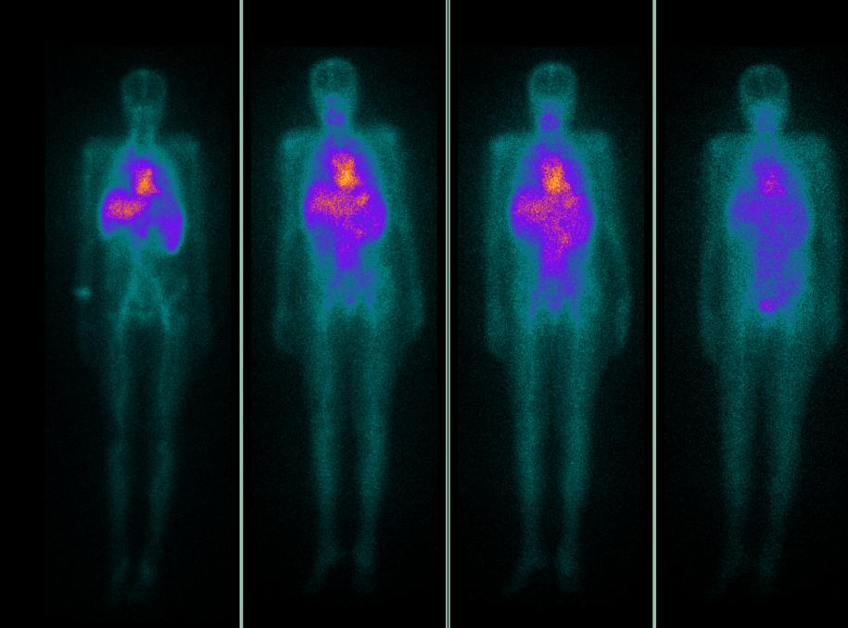
Patient 1- Retention time= 167.54 hrs, Calculated therapeutic activity= 30.45mCi
FDG PET/CT ¹³¹I-Rituximab D0 D1 D2 D7

Slide 31
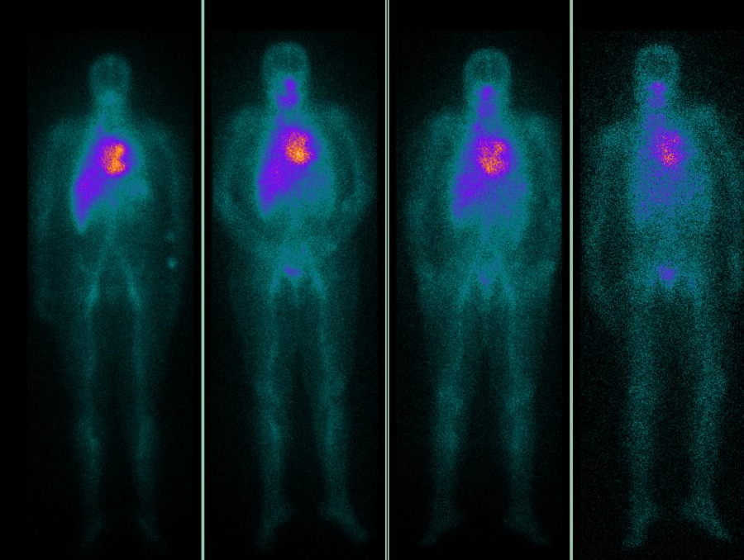
Patient 2 Retention time= 93.77 hrs, Calculated therapeutic activity= 86.79mCi
FDG PET/CT 131-Rituximab D0 D1 D2 D7

Slide 32
¹⁷⁷Lu Trastuzumab Imaging & Treatment
Final preparation and QC done at Nucl Med Dept –TMH
&
Radiopharmaceuticalchemistry Section BARC

Slide 33
Case 1
LT BREAST - LABC - 2015 CORE BX 1DC 2 , ER NEG , PR NEG , HER2 positive
4# EC--> 12 # WEEKLY TAXOL
Post LT MRM in 2015 followed by LRRT 50 GY / 25# LD 22.7.16
On f/u epigastric pain - 1.5 months
CXR - NAD USG - MULTIPLE LIVER METS , LD 6 CM + PALN (1.2 CM)

Slide 34
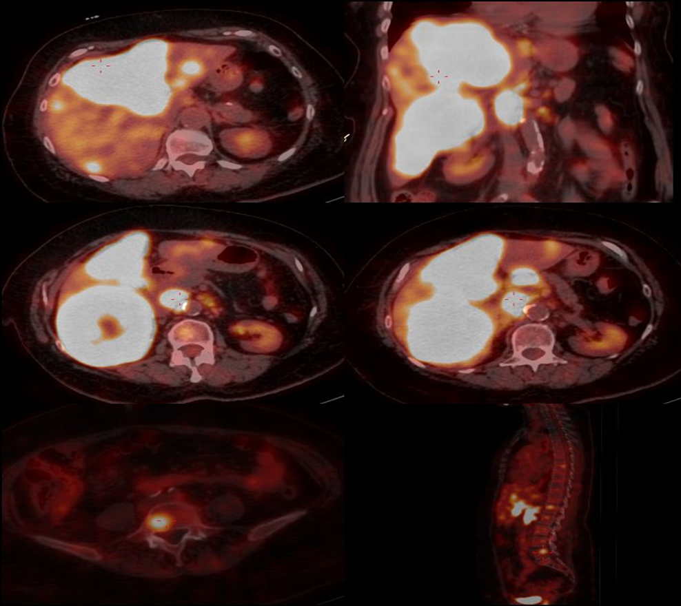
HUGE LIVER METS IN LIVER
PET scan image

Slide 35
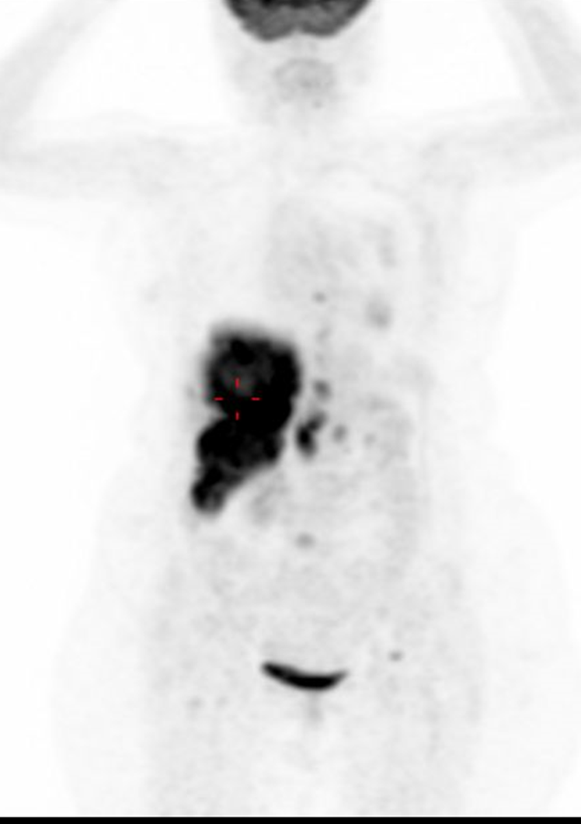
UPTAKE IN LIVER METS
¹⁷⁷Lu-Trastuzumab image

Slide 36
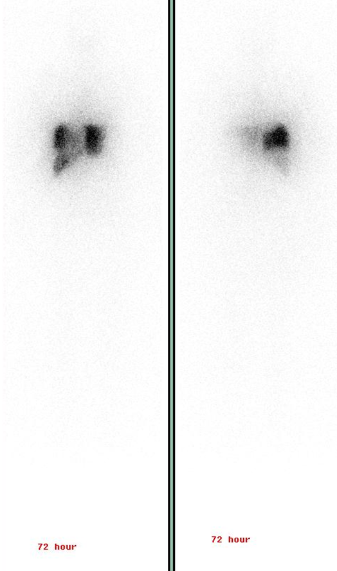
UPTAKE IN LIVER METS AND RETENTION. NEARLY MOST OF THE UPTAKE OF THE TRACER IS IN LIVER
¹⁷⁷Lu-Trastuzumab images

Slide 37
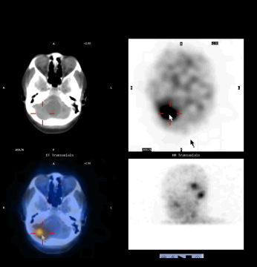
Case 2
SPECT/CT SHOWING PROMINENT UPTAKE IN THE 2 BRAIN LESIONS

Slide 38
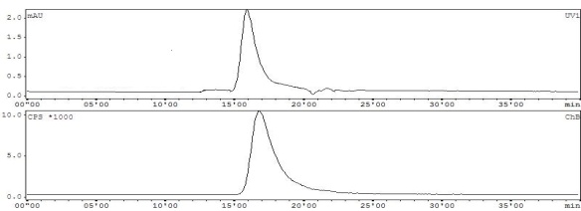
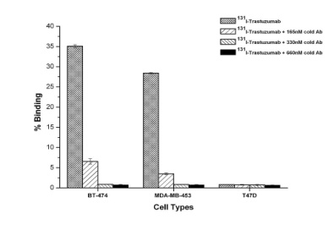
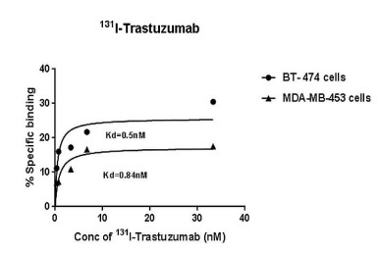
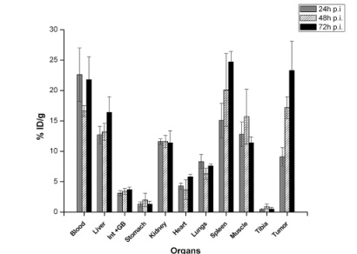
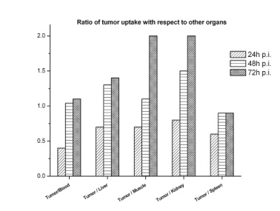
Radiolabeled Antibodies Yet to reach the Clinics
Lab Scale Studies Completed -- Standardization, Radiolabeling, Characterization and Stability testing of the radioimmunoconjugate, Bioevaluation studies both in vitro and in vivo (in normal & tumor bearing animals)
These include:
⁹⁰Y-Rituximab
^{99m}Tc-Rituximab – also tested for SND
¹³¹I-Trastuzumab
¹⁷⁷Lu-Trastuzumab – work initiated for cold kits prep
¹³¹I-Bevacizumab
^{99m}Tc-Bevacizumab
¹⁷⁷Lu-Bevacizumab (Cold Kit)
¹³¹I-Nimotuzumab
¹⁷⁷Lu-Nimotuzumab (Cold Kit)

Slide 39
Therapeutic Radiopharmaceuticals
Palliative - Bone pain
Radiolabeled phosphonates
⁸⁹Sr Chloride, ³²P-phosphate, ¹⁵³Sm-EDTMP, ¹⁸⁸Re-HEDP , ¹⁸⁸Re-CTMP, ¹⁷⁷Lu-DOTMP, ¹⁷⁵Yb-DOTMP
Liver cancer treatment
colloids/particulates - through hepatic artery
¹⁶⁶Ho-chitosan, ⁹⁰Y-glass microspheres, ¹⁸⁸Re-Sn colloid

Slide 40
Nuclear Imaging and Treatment are wonderful examples of ‘Precision’ or ‘Personalized’ medicine that is being discussed and pursued all over the world.

Slide 41
Focus of research
Drug repositioning and novel payload addition
Radioimmuno diagnostics and therapy
Theranostic using novel peptides, biological products
Dosimetry and personalized therapy
Radionomics

Slide 42
Thank you

